Slide 1

Do You It?
Pete Brown
Systems Engineer, AutoZone

Slide 2
Who am I?
Started off fixing laptops in 1999
Supported various areas of enterprise infrastructure
Windows & Linux OS
Virtualization
Messaging
Database
Network
Unified Communications
Serious case of ADHD ☺
Started OOP ~2013
Maintain free utilities for UC engineers
Developing Declarative Resource Protocol
Motivation - Wife, 5 girls & 2 dogs

Slide 3
Why this talk?
Share your great ideas
Collaborate with others
Safeguard your code
Standardize documentation

Slide 4
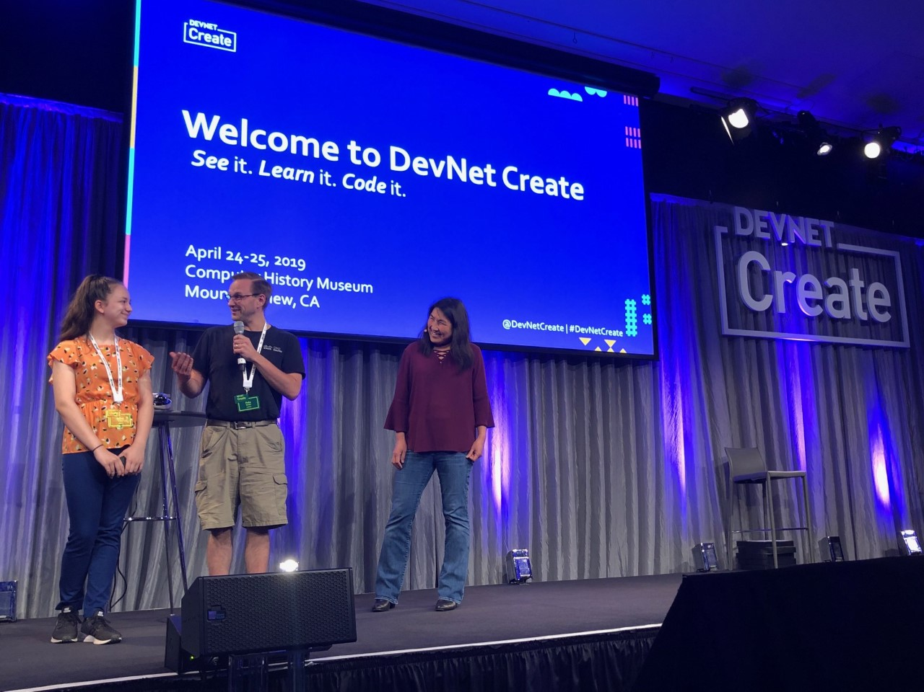
Why this talk?

Slide 5

What is GitHub?
Web based service for version control using Git
Provides access control and collaboration features
Offers multiple account tiers for different project types
Started in 2008 in San Francisco
Acquired by Microsoft in 2018 for $7.5 billion

Slide 6




Popular Git Providers
GitHub
GitLab
Azure Repos (Visual Studio Team Services)
Atlassian Bitbucket
CloudForge

Slide 7
Predecessors of Git
CVS - Concurrent Versions System (1986)
SVN – Subversion (2000)
BK – BitKeeper (2000)

Slide 8
History of Git
Created by Linus Torvalds
Development began 4/3/2005
Managed Linux Kernel 2.6.12 release on 6/16/2005
Version 1.0 released 12/21/2005

Slide 9
Git Design Criteria
Take CVS as an example of what not to do
Support a distributed, BitKeeper-like workflow
Include very strong safeguards against corruption, either accidental or malicious

Slide 10
Git Supported Protocols
Local file
HTTPS
SSH
Git (port 9418)

Slide 11
Let’s Make a Repo!

Slide 12
Common Operations
Clone => Create local copy of branch
Checkout => Create or switch to a branch
Commit => Commit changes to staging
Pull => Pull changes from server to local copy
Push => Push staged changes to server

Slide 13
References
GitHub Guides
https://guides.github.com/activities/hello-world/
https://guides.github.com/features/mastering-markdown/
GitHub Cheat Sheet
https://education.github.com/git-cheat-sheet-education.pdf
Other
https://en.wikipedia.org/wiki/Git
https://github.com/joshnh/Git-Commands
https://git-scm.com/book/en/v2/Git-on-the-Server-The-Protocols

